Slide 1
Ocean Motion
Part 1: Waves
Mr. Coleman

Slide 2
?
Why does the Ocean have waves?
What are the parts of a wave?
How does water move in a wave?
What happens when a wave hits a beach?

Slide 3
Define wave:
Wave – a rhythmic movement that carries energy through matter or space.
in the ocean, waves move through seawater.

Slide 4
Parts of a wave
Wave height
Wavelength
Crest
Crest
Trough

Slide 5
Parts of a wave:
Crest – the highest part of a wave.
Trough – the lowest part of a wave.
Wavelength – the distance between two adjacent crests.
Wave height – the vertical distance between the lowest part and the highest part.

Slide 6
More wave words
Frequency – the number of complete waves (or oscillations) that occur over a given period of time. Usually measured in cycles per second.
Amplitude – half the wave height
But Mr. Coleman, why do we have to learn vocabulary words that aren’t in the book?
For the FCAT!

Slide 7
Most waves caused by wind
Friction from the wind moving over the water causes the water to move along with the wind.
If the wind speed is high enough, the water begins to pile up and a wave is formed.

Slide 8
How does water move in a wave?
Some clues:
When you were at the beach, you probably noticed that the edge of the water goes back and forth with the waves.
If you float an object on the ocean, it stays roughly in one place. It is not pushed forward by the waves.

Slide 9
How water moves in a wave:
At a depth about equal to half the wavelength, the motion stops.
Particles of water move around in circles. The farther below the surface, the smaller the circle.

Slide 10
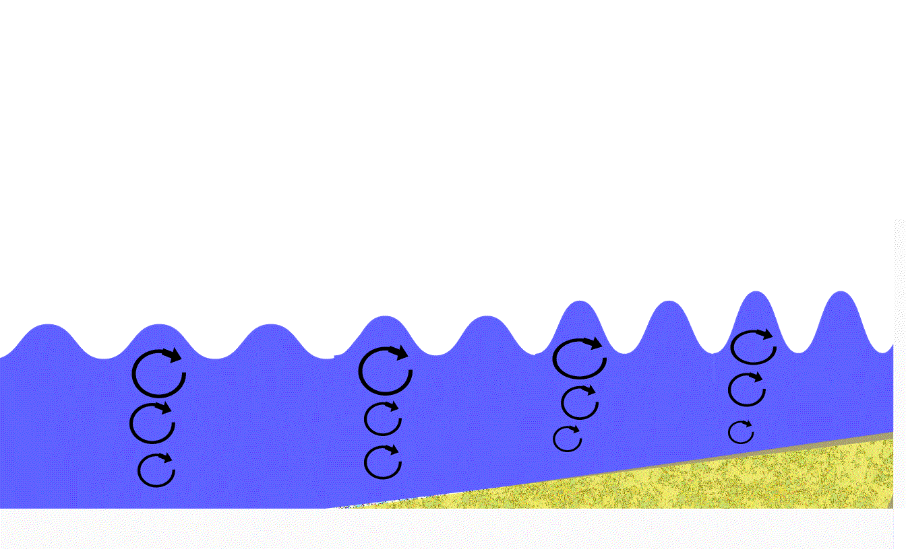
At the beach:
Wavelength decrease and wave height increases as waves approach the shore.
Constant
Wavelength
Waves drag against the bottom
and wave length decreases

Slide 11
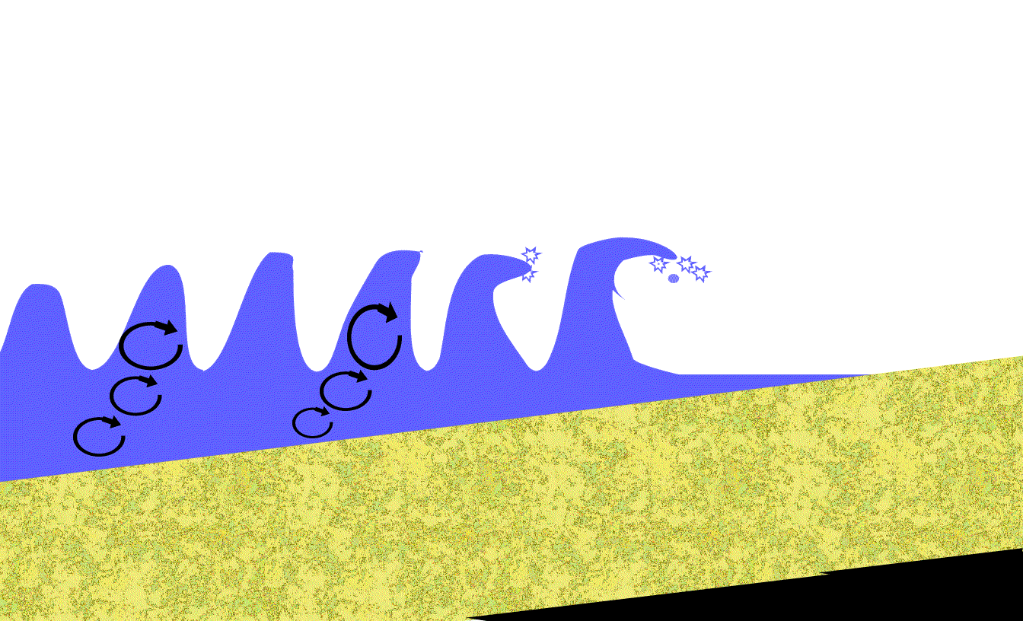
At the beach, part 2
As the wave slows, its crest and trough come closer together. The top of the wave is not slowed by friction and moves faster than the bottom.
The top of the wave outruns the bottom and falls over. This collapsing wave is called a breaker.

Slide 12
Now we wave goodbye to this part of the lesson,
for now.

Slide 13
This powerpoint was kindly donated to www.worldofteaching.com
http://www.worldofteaching.com is home to over a thousand powerpoints submitted by teachers. This is a completely free site and requires no registration. Please visit and I hope it will help in your teaching.

